Slide 1
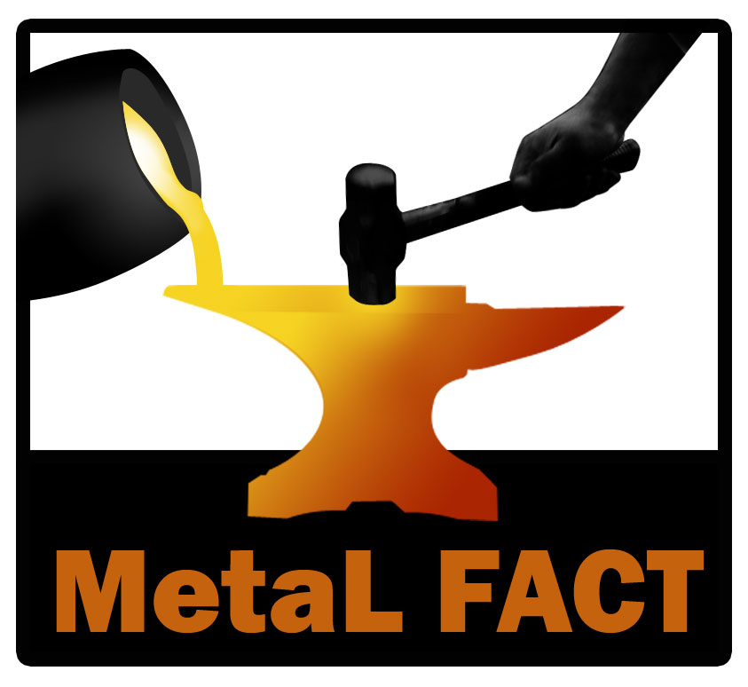
Castings and Forgings
Maritime & Land Forging And Casting Team
Notes:
Our team is in place to support the Maritime and Land Supply chains.

Slide 2



DSCC’s MetaLFACT
Provides casting & forging assistance
MetaLFACT is comprised of Government and Industry representation
MetaLFACT is a resource available to the following
  DLA Personnel: Product Specialists, Buyers, Planners
  Engineering Support Activities (ESAs)
  Contractors/Suppliers
    With active DSCC contracts (w/Contracting Officers’ approval)
    Bidding on open DSCC solicitations
Tools to provide assistance
Notes:
Our team VE, Land, Maritime, and Contractors. TO support a variety of persons and offices with a variety of tools.

Slide 3
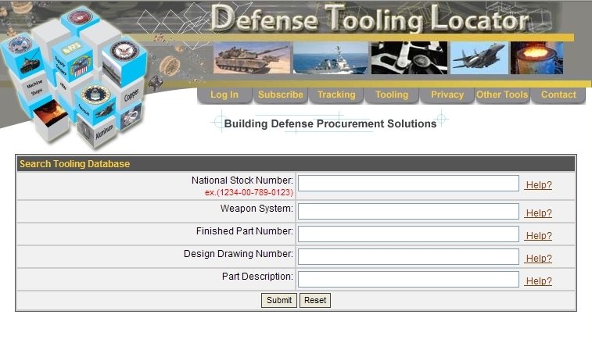
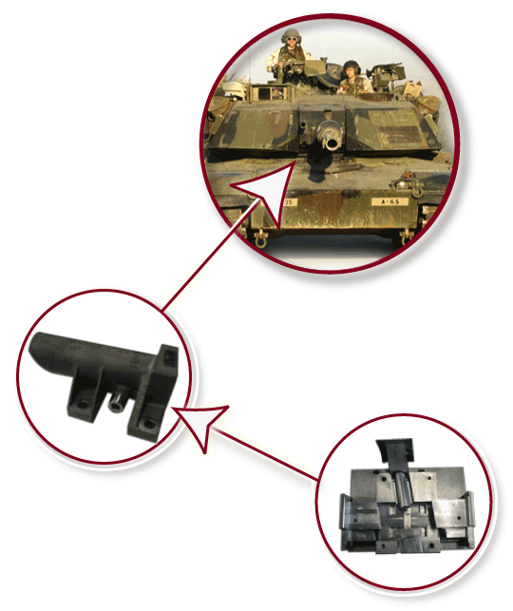
Cast Tooling Database
www.defensetooling.com
Population
  >120 companies
  >25,000 tooling records
Utilized by ICP’s
Assist defense contractors in finding tooling
  50% success rate of matching inquiries to patterns/suppliers
Company notified each time gov’t buying parts for which they have tooling
$1.5 million in orders directed to participants each month
Notes:
1 of the major outcomes of the program is the Casting tooling db. It is in place to enable the Gov to identify the location of tools available. This will enable us to reduce costs by not constantly paying for tooling development on each buy.

Slide 4
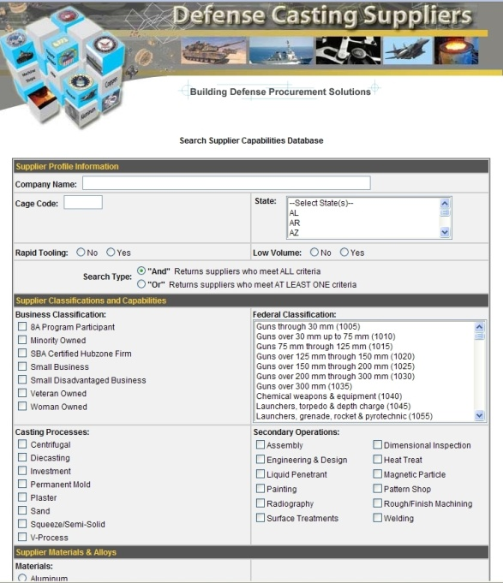
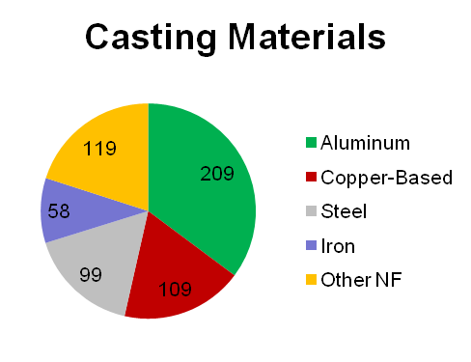
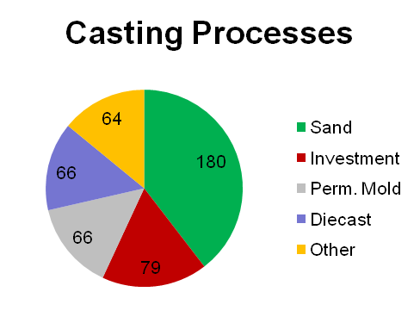
Casting Suppliers Database
www.defensecastingsuppliers.com
Online directory of metalcasters serving the defense industry
Utilized by government and defense contractors
256 Registered Metalcasters
  All Processes & Materials
Casting bid solicitations matched to plant capabilities
Notes:
The defense casting suppliers database is an online resource that is freely available to identify companies that currently or wish to manufacture castings for defense applications. The search engine is currently online and available at the URL shown. A buyer can search for a casting supplier by the following:
Casting process, material, size range of casting produced, secondary operations, small business classifications (8A, Hubzone, etc.), federal supply codes, quality system, low volume capabilities, rapid prototyping capabilities, etc.

Slide 5
National Forging Tooling
Database (NFTD)
Purpose
  Rapidly locate forging dies for legacy weapon systems
Benefits
  Web base database
    Locates forging dies and suppliers
    Widely accessible through Haystack Gold
  Reduces ALT and PLT
  Avoids costs of designing/building new dies
    Huge benefit for small order sizes
  Sustainable beyond the life of the FAST Program

Slide 6
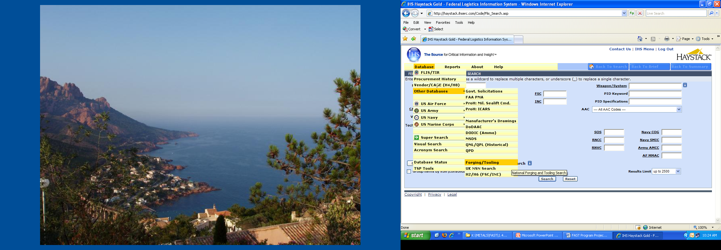
Navigating NFTD
Method: Log into Haystack Gold
Select the Database drop-down menu
Select “Other Databases”, then “Forging/Tooling”

Slide 7
Forging Industry Association Website
  http://www.forging.org
Locate Forge Shops
Submit Request for Quotes (RFQs)
For Direct DLA submission for Assistance on
Land or Maritime NSN’s:
dscc.cast.forge@dla.mil

